Slide 1


Group Ios
Memory Management in iOS applications
We can't imagine a technology enhancement without memory in today's tech world. The memory includes the hardware which is used to store information on the device. As far as iPhone is concerned
Presented By -
Amol

Slide 2








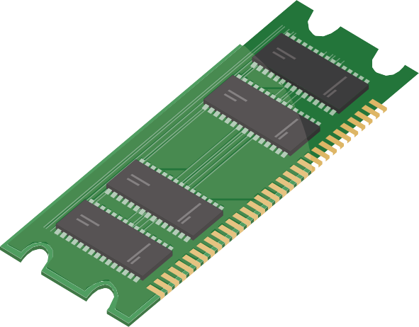


Automatic Reference Counting (ARC) in Swift
swift uses a smarter way for managing the memory, I.e., Automatic Reference Counting (ARC). It automatically frees up the memory used by the class instances when we don't require them. However, as we have already stated in this article, Automatic Reference Counting (ARC) applies only to the class instances.
Structure and Enumerations are Value types in swift, and therefore, their instances are not counted.
ARC allocates the chunk of memory to store information about the instance whenever created in our app code. The information contains the instance's type, including the value of any stored property associated with the instance. ARC also frees up the memory when the instance is no longer needed. In this scenario, the memory used by that instance gets freed and used for other purposes instead. This also ensures that the instances don't take up unnecessary space in the memory when they are not used.

Slide 3


3.Use Lazy Loading: Lazy loading is a technique where objects are loaded only when they are needed. This helps to conserve memory by avoiding the loading of objects that are not currently needed
ARC is an automated memory management
4.Use Instruments: The Instruments tool provided by Xcode can help you identify memory leaks and other memory-related issues. It is important to use Instruments regularly to identify and fix memory-related problems.
Use ARC (Automatic Reference Counting): ARC is an automated memory management system that is built into the Objective-C and Swift programming languages. It automatically manages the memory of objects by keeping track of how many references to an object exist, and it frees up memory when an object is no longer needed. ARC makes memory management easier and less error-prone.
Release Unused Objects: It is essential to release objects that are no longer needed to free up memory. This can be done by setting the object to nil or by releasing it explicitly using the release method.
5.Use @autoreleasepool: The @autoreleasepool keyword in Objective-C is used to create a pool of temporary objects that are automatically released when the pool is drained. This can be used to manage the memory of temporary objects more efficiently.

